Slide 1
Exploring the Correlation Between the Crime Rate and Avenues in NY City Aoune Barhoumi June 16, 2020

Slide 2
Objective of the Project:
We will explore the correlation between the crime rate and the avenues in NY city

Slide 3
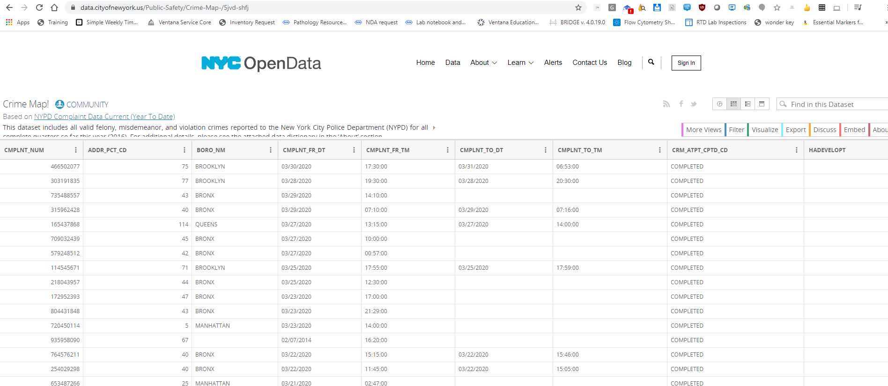
Crime map in NYPD
https://data.cityofnewyork.us/Public-Safety/Crime-Map-/5jvd-shfj
This dataset includes all valid felony, misdemeanor, and violation crimes reported to the New York City Police Department (NYPD) for all complete quarters from 1974 till 2020.

Slide 4
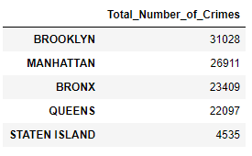
Total Number of Crimes in NY Boroughs
NY city 5 boroughs ranked based on the total number of committed crimes between the years 1974 and 2020

Slide 5

Foursquare
Foursquare is a location technology platform

Slide 6
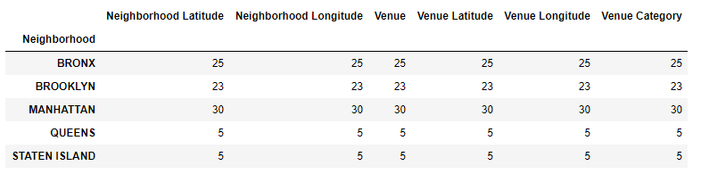
Boroughs Venues
Total number of venues in the 5 boroughs when searched with the boroughs coordinates.

Slide 7
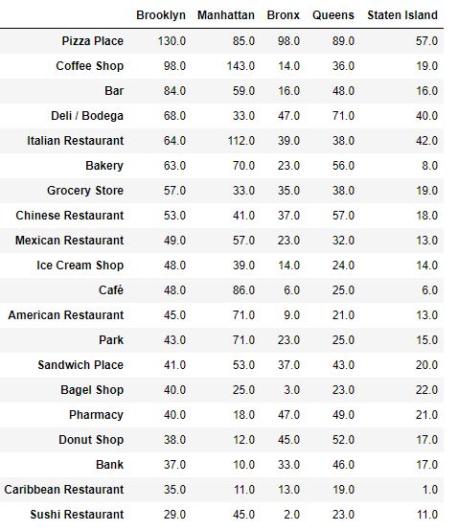
Boroughs Venues
Total number of venues in the 5 boroughs when searched with the neighborhoods coordinates.

Slide 8
Conclusion
Even though we determined the crime rate in the five NY boroughs as well as the venues categorized based on type we could not see a clear correlation between the two
Further analysis could required to tease out any correlation between crime rate and venues

